Slide 1


Slide 2
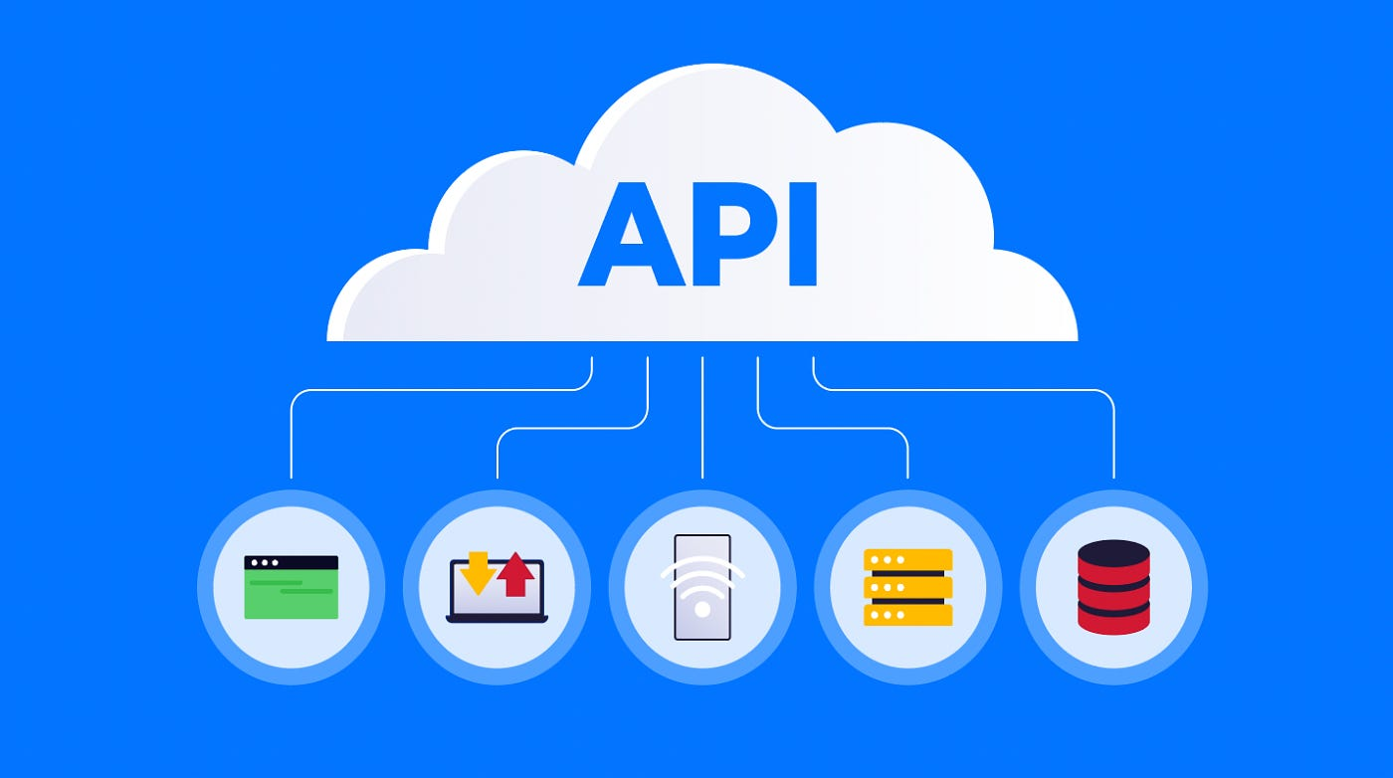
Introduction to
Consuming APIs with Requests

Slide 3
What is an API?
Definition
Allows different software systems to communicate with each other
Analogy
API as a waiter. Client place an order (request) with the waiter (API), who then communicates with the kitchen (server) and returns the meal (response) to you.
Components
Endpoint
Request
The URL where the API can be accessed
Data sent to the API
Method
Response
The type of request (e.g., GET, POST)
Data received from the API

Slide 4
Types of APIs
Web APIs
Interfaces accessible over the internet via HTTP/HTTPS
REST
Representational State Transfer; uses standard HTTP methods
SOAP
Representational State Transfer; uses standard HTTP methods
Library APIs
Provided by programming libraries to perform specific tasks
Operating System APIs
Interfaces for interacting with system hardware

Slide 5
Common API Protocols
HTTP/HTTPS
The foundation for communication between clients and
servers on the web
REST (Representational State Transfer)
Stateless
Provided by programming libraries to perform specific tasks
Resource-Based
Interaction with resources (data entities) using URLs
HTTP Methods
GET, POST, PUT, DELETE
SOAP (Simple Object Access Protocol)
XML-Based
Uses XML for messaging
Protocol-Based
Operates over HTTP, SMTP, or other protocols
Standardized
Includes standards for security, transactions, etc

Slide 6
Understanding API Requests and Responses
Request Components
URL
Endpoint address (e.g., https://api.example.com/resource)
Method
Type of request (GET, POST, PUT, DELETE)
Headers
Metadata (e.g., Content-Type, Authorization)
Body
Data sent with the request (for POST and PUT)
Response Components
Status Code
Indicates success or failure (e.g., 200 OK, 404 Not Found)
Body
The data returned from the API, usually in JSON or XML format
Headers
Metadata about the response (e.g., Content-Type, Content-Length)

Slide 7
Introduction to the requests Library
Purpose
Simplifies sending HTTP requests and handling responses in Python
Installation
pip install requests
Basic Features
GET Requests
Fetch data from a server
POST Requests
Send data to a server
Handling Responses
Accessing status codes, response content, etc

Slide 8
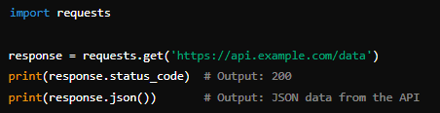
Making a GET Request with requests
Code Example
Explanation
URL
The endpoint you are accessing
Response
The server’s reply, which includes status and data
Status Code
Indicates whether the request was successful
JSON Data
Parsed response data

Slide 9
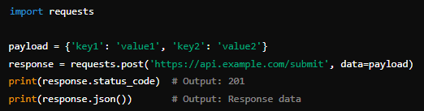
Making a POST Request with requests
Code Example
Explanation
Payload
Data sent to the server
Response
Server’s reply, usually indicating success or failure
Status Code
Shows the result of the request

Slide 10
Handling API Responses
Status Codes
200 OK
The request was successful
201 Created
Resource was successfully created
400 Bad Request
The server could not understand the request
401 Unauthorized
Authentication is required
404 Not Found
The requested resource was not found
500 Internal Server Error
An error occurred on the server
Response Methods
response.text
Returns raw text data
response.json()
Parses JSON response data into a Python dictionary

Slide 11
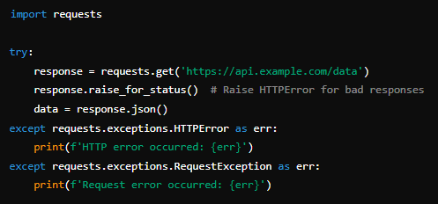
Error Handling
Example
Explanation
raise_for_status()
Raises an exception for HTTP errors
Exception Handling
Manage errors to ensure robust code

Slide 12

Name two types of API protocols
REST (Representational State Transfer) and SOAP (Simple Object Access Protocol)
What HTTP method would you use to retrieve data from an API?
GET
What Python library is commonly used to send HTTP requests?
requests
How do you install the requests library?
pip install requests
What is the purpose of the response.json() method in the requests library?
To parse the JSON data returned in the response body into a Python dictionary
What is an endpoint in the context of an API?
The URL where the API can be accessed

Slide 13

Create a simple weather dashboard that fetches and displays current weather information for a specified city using a weather API

